Slide 1

Bir Kelime Bir İşlem
Math-Vocablary
A Project by Yusuf Levent

Slide 2
Purpose
Cognitive Challenge: Test verbal and numerical skills under time pressure.
Rapid Decision Making: Make optimal choices quickly in competitive scenarios.
Problem Solving: Transform randomized data into meaningful solutions.

Slide 3
Learning Outcomes
Mathematical Fluency: Master mental calculation and combinatorial thinking.
Vocabulary Expansion: Build active word knowledge from letter sequences.

Slide 4
Two Thrilling Game Modes
Word Game
Number Game
Build the longest word from random letters using intuitive right-click selection and a helpful Joker panel.
Hit the target number with five random digits and four operations through strategic drag-and-drop calculations.

Slide 5
Screens
1
2
3
Menu
Word Game
Number Game
4
5
Winner Menu
Game Over Menu

Slide 6
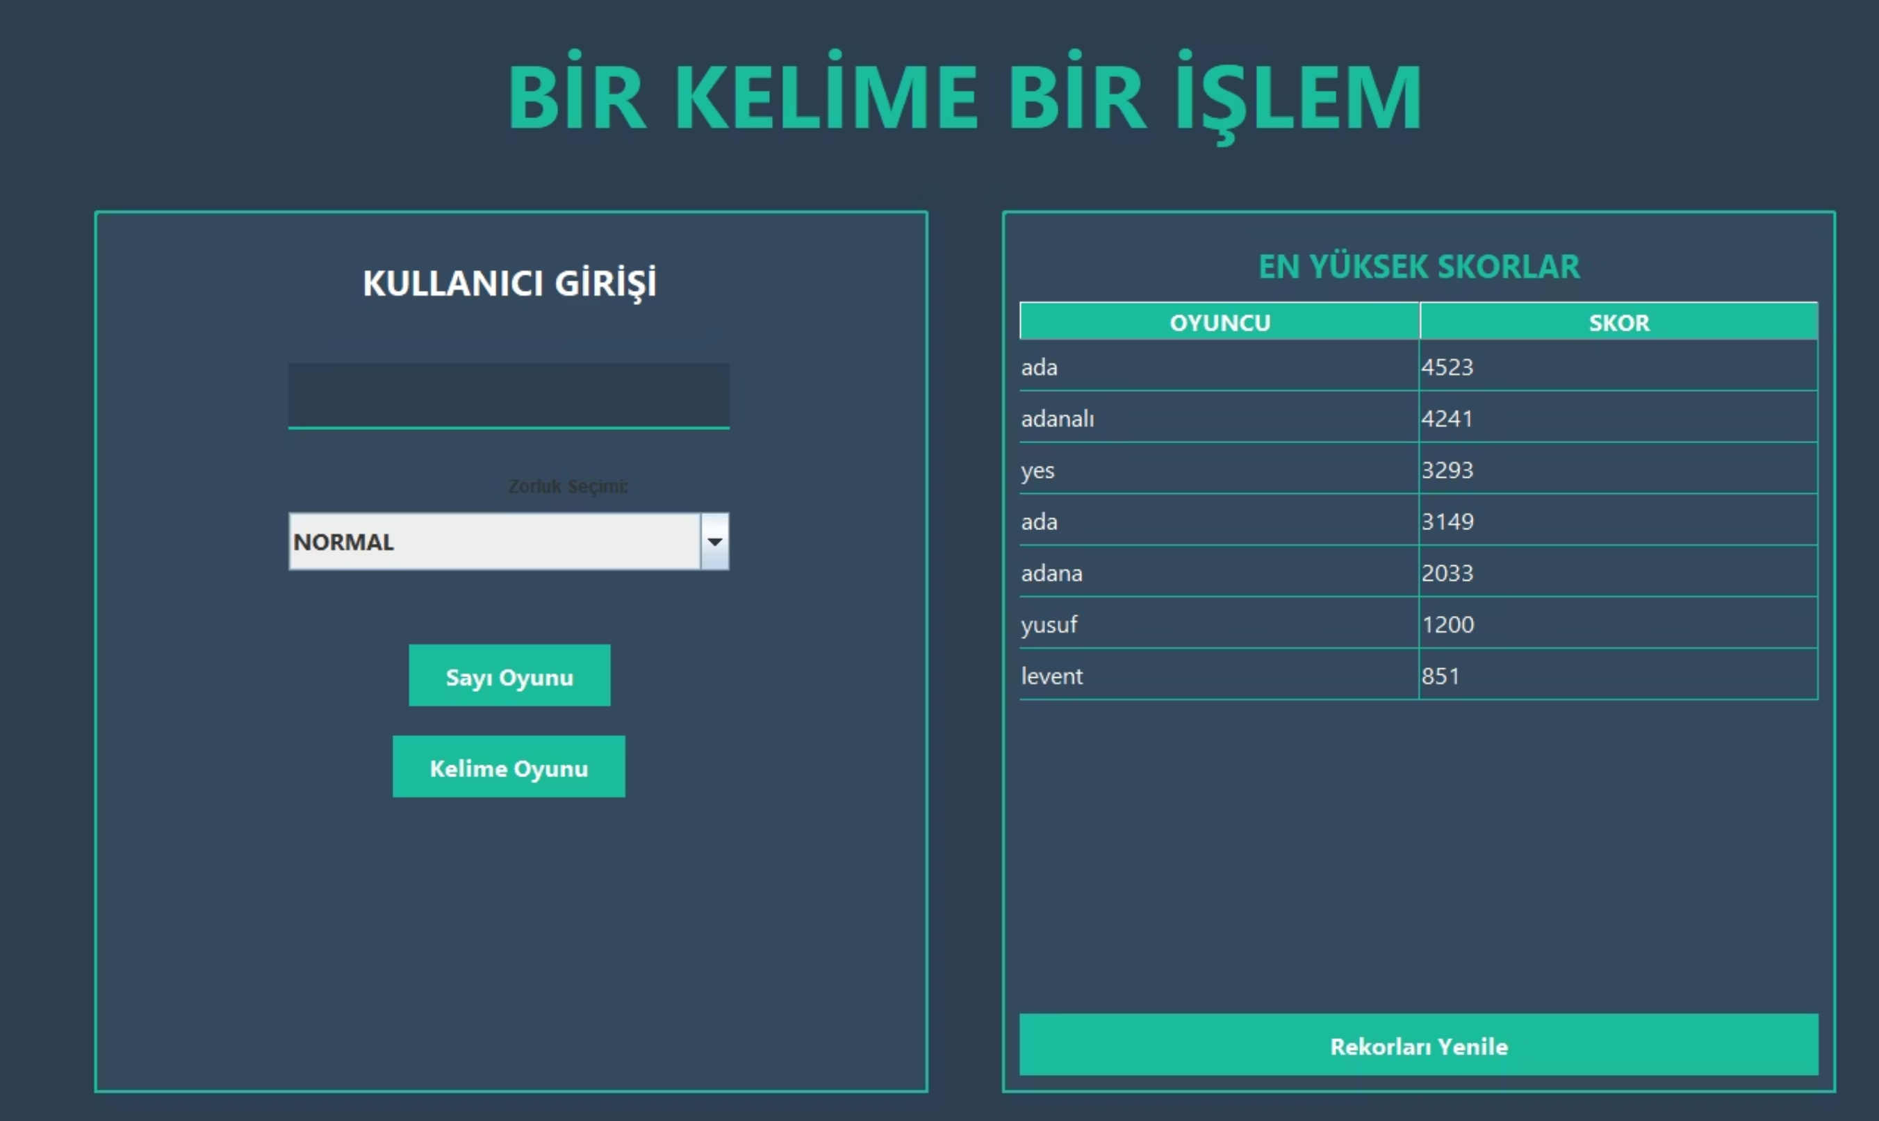
Menu

Slide 7
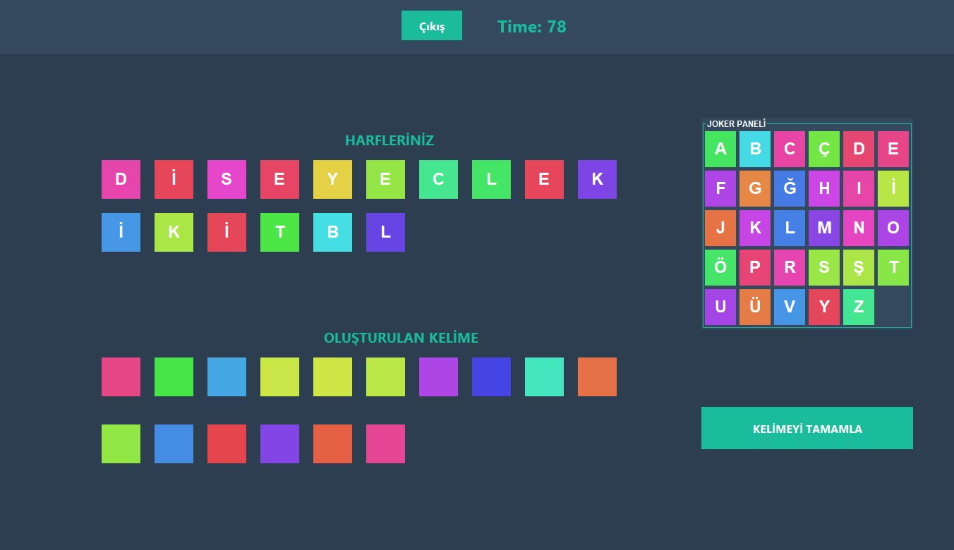
Word Game Screen

Slide 8
Word Game: Lexical Challenge
Construct the longest possible word from a set of random letters before time runs out. Master your vocabulary under pressure!
01
02
Select Letters
Use Jokers Wisely
Right-click any letter to add it to your word construction area automatically.
Need an extra letter? Grab one from the Joker Panel on the left to complete your word.
03
04
Correct Mistakes
Beat the Clock
Left-click letters in your word area to return them to their original positions.
Submit before time expires, or view a valid solution in the Game Over screen.

Slide 9
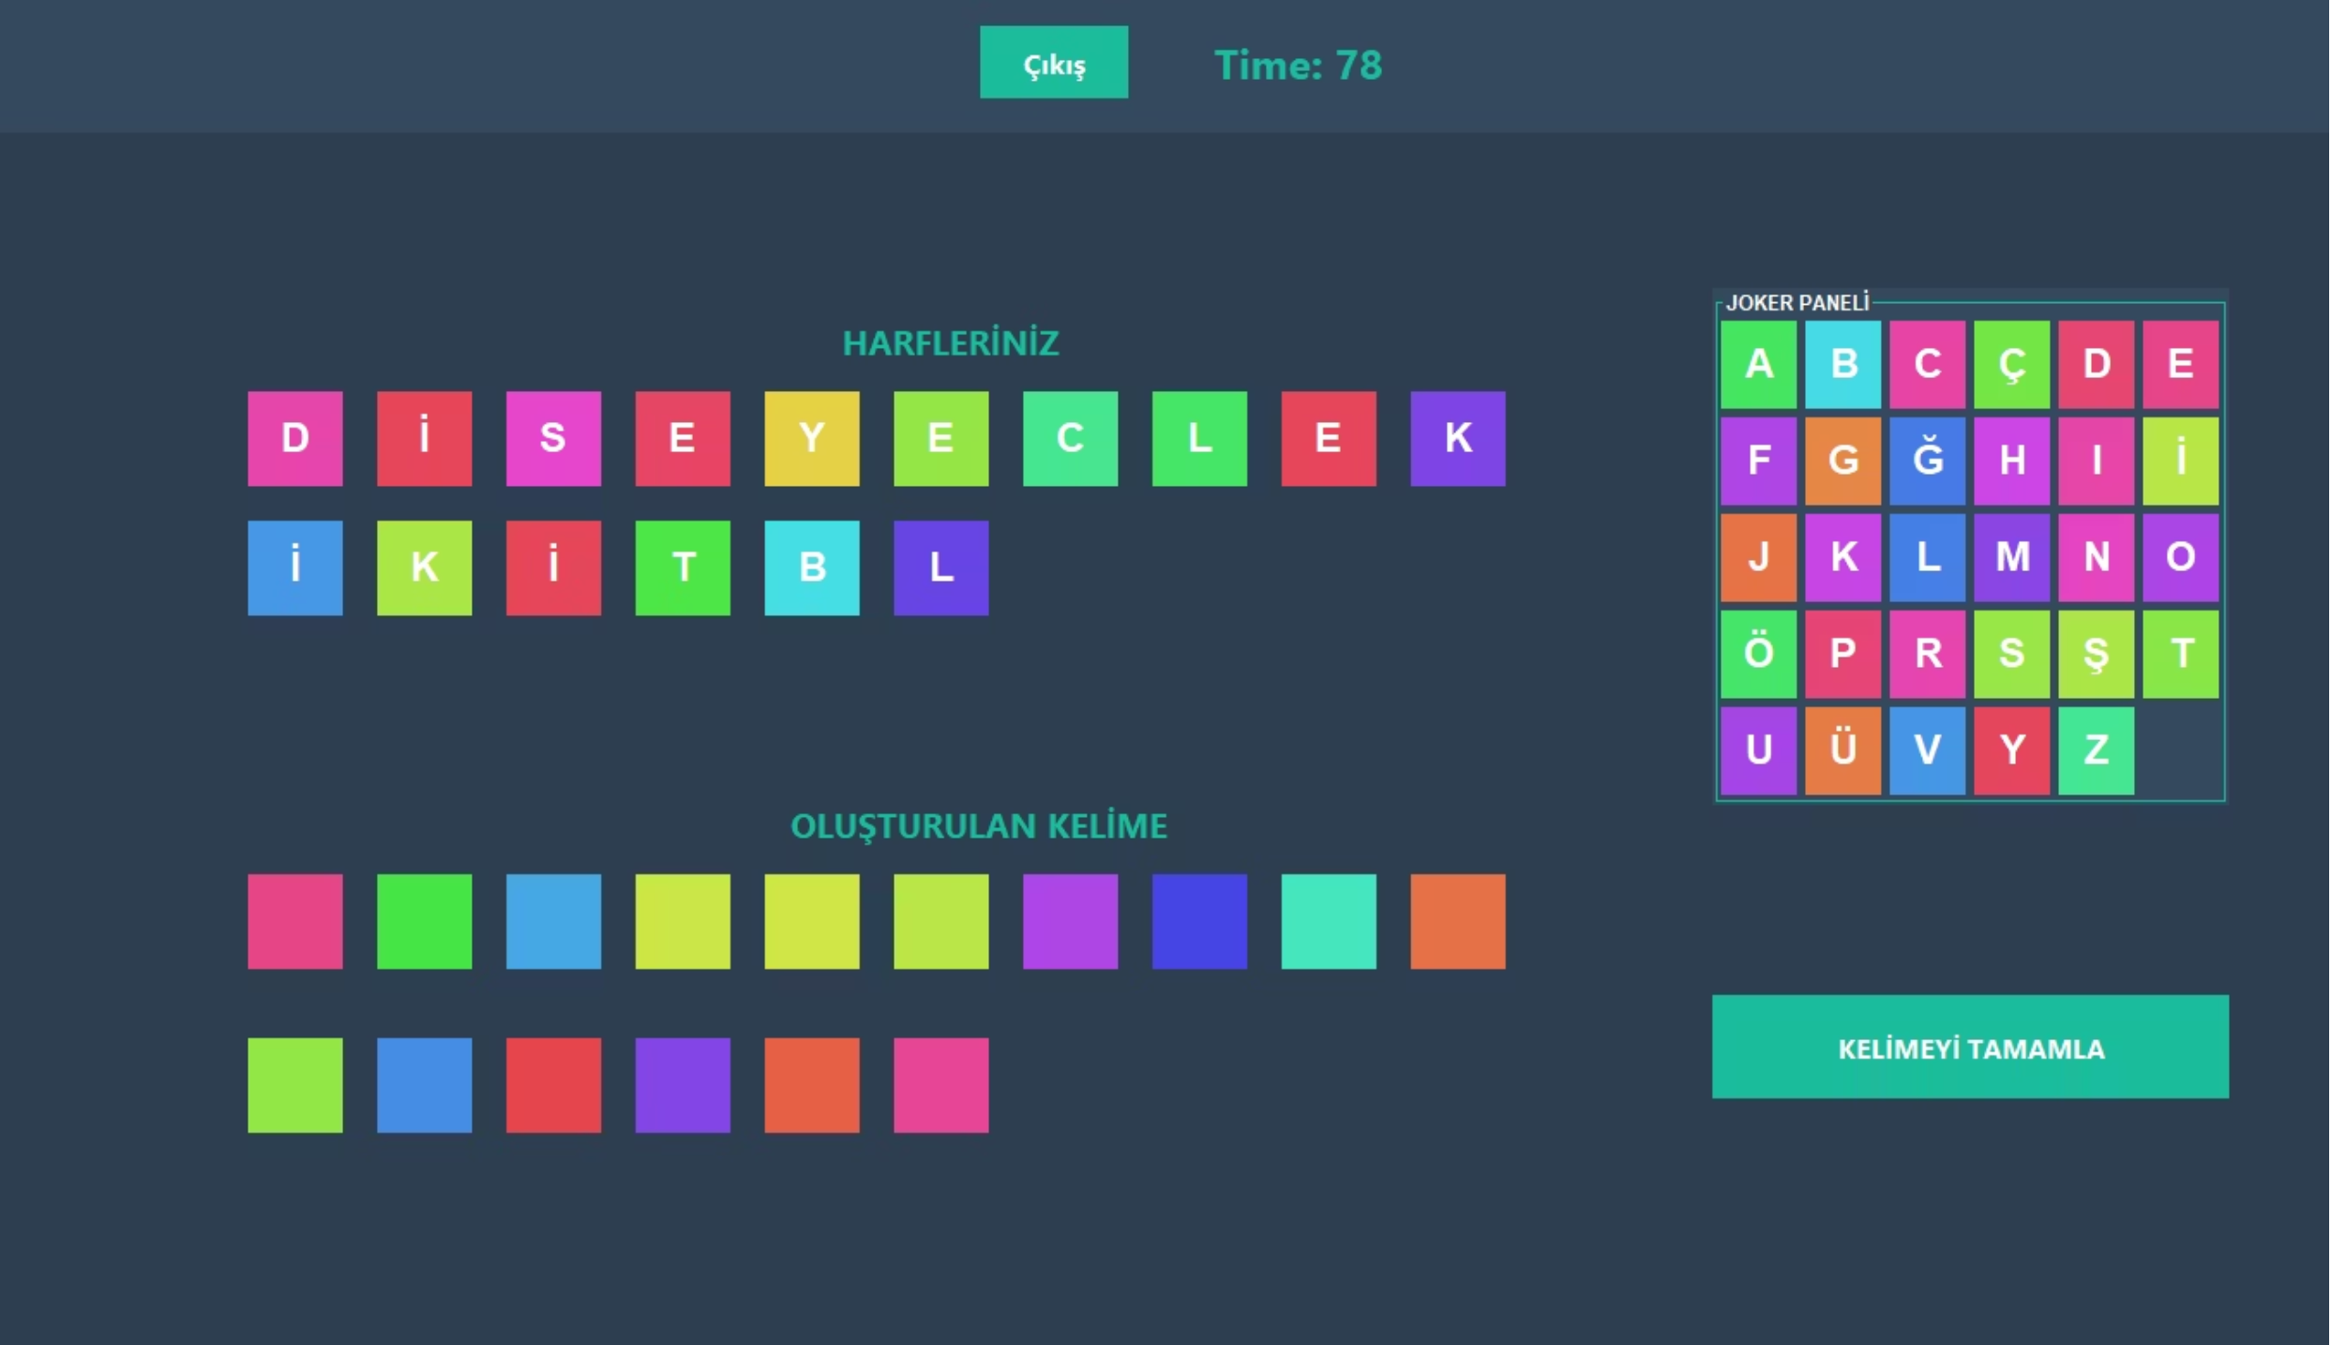
Word Game
Scoring System
Time Bonus: Quick completion rewards
Word Length Bonus: Longer words = higher scores
Joker Efficiency: Unused Jokers earn bonus points
Difficulty Multiplier: Difficulty level multiplies your score

Slide 10
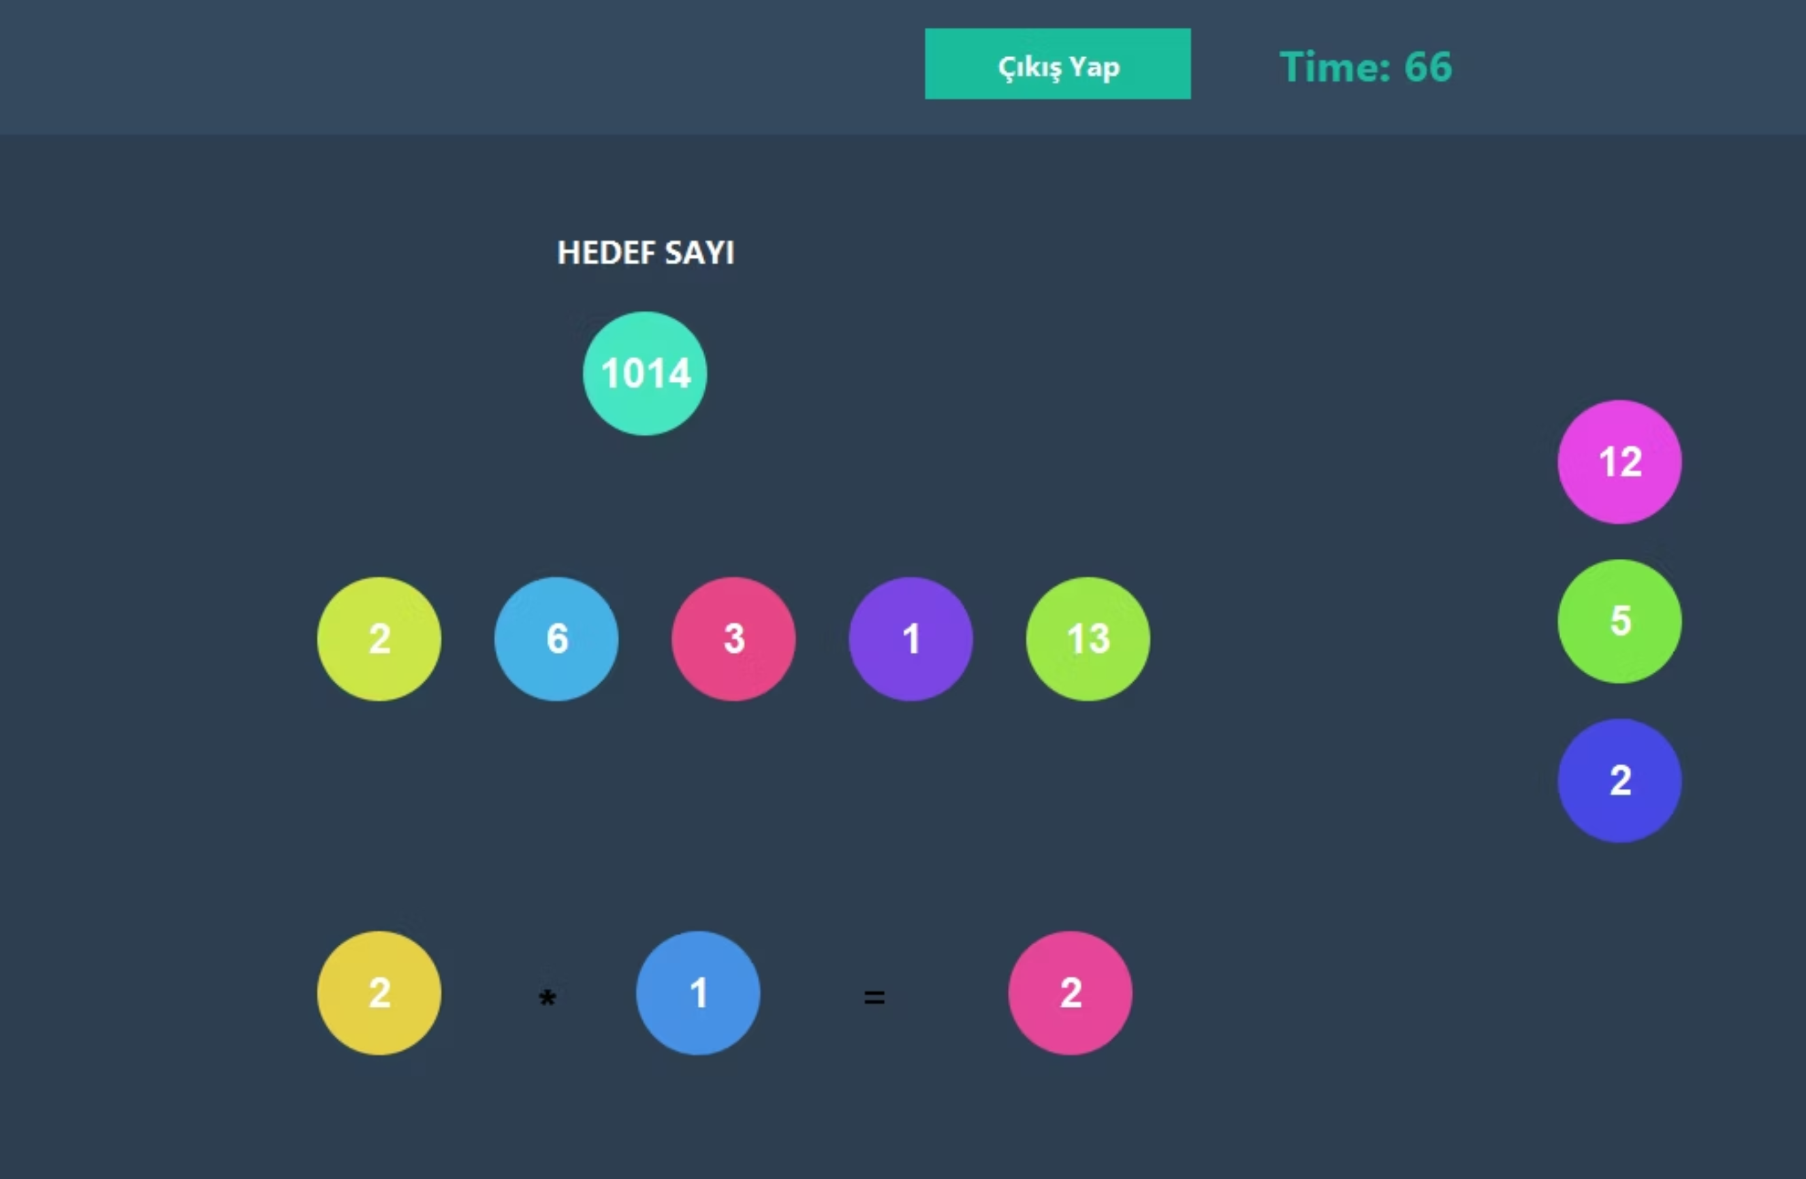
Number Game Screen

Slide 11




Number Game: Mathematical Mastery
Reach the target number using five random numbers and basic operations. Strategic thinking meets arithmetic agility in this race against time.
Drag Numbers
Select two numbers and drop them into operation slots at the bottom.
Choose Operator
Cycle through +, -, ×, ÷ by clicking the operator button.
Calculate Result
Hit equals to save the result in your running list for future use.
Hit Target
Match the target exactly to win instantly and record your score!

Slide 12

Number Game
Scoring System
Time Efficiency: Remaining time = bonus points
Operation Count: Fewer operations = higher scores
Difficulty Multiplier: Difficulty level multiplies your score

Slide 13
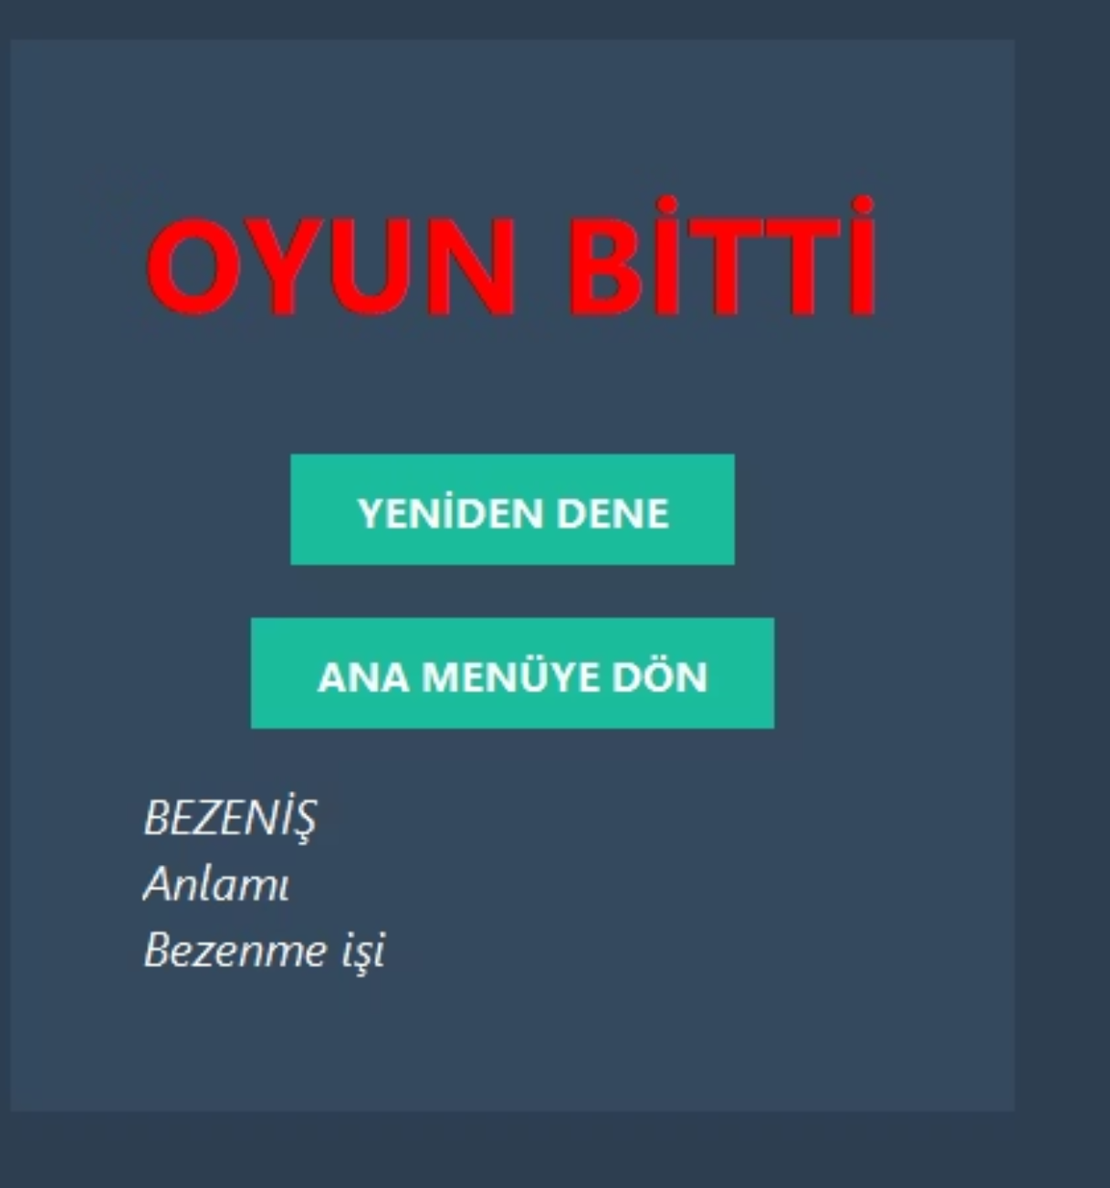
Game Over For Word Game
Invalid Word: Submitting a word not in the dictionary triggers Game Over
Time Expired: Running out of time ends the round
Solution Display: View a valid word from your letters and its meaning on the Game Over screen

Slide 14
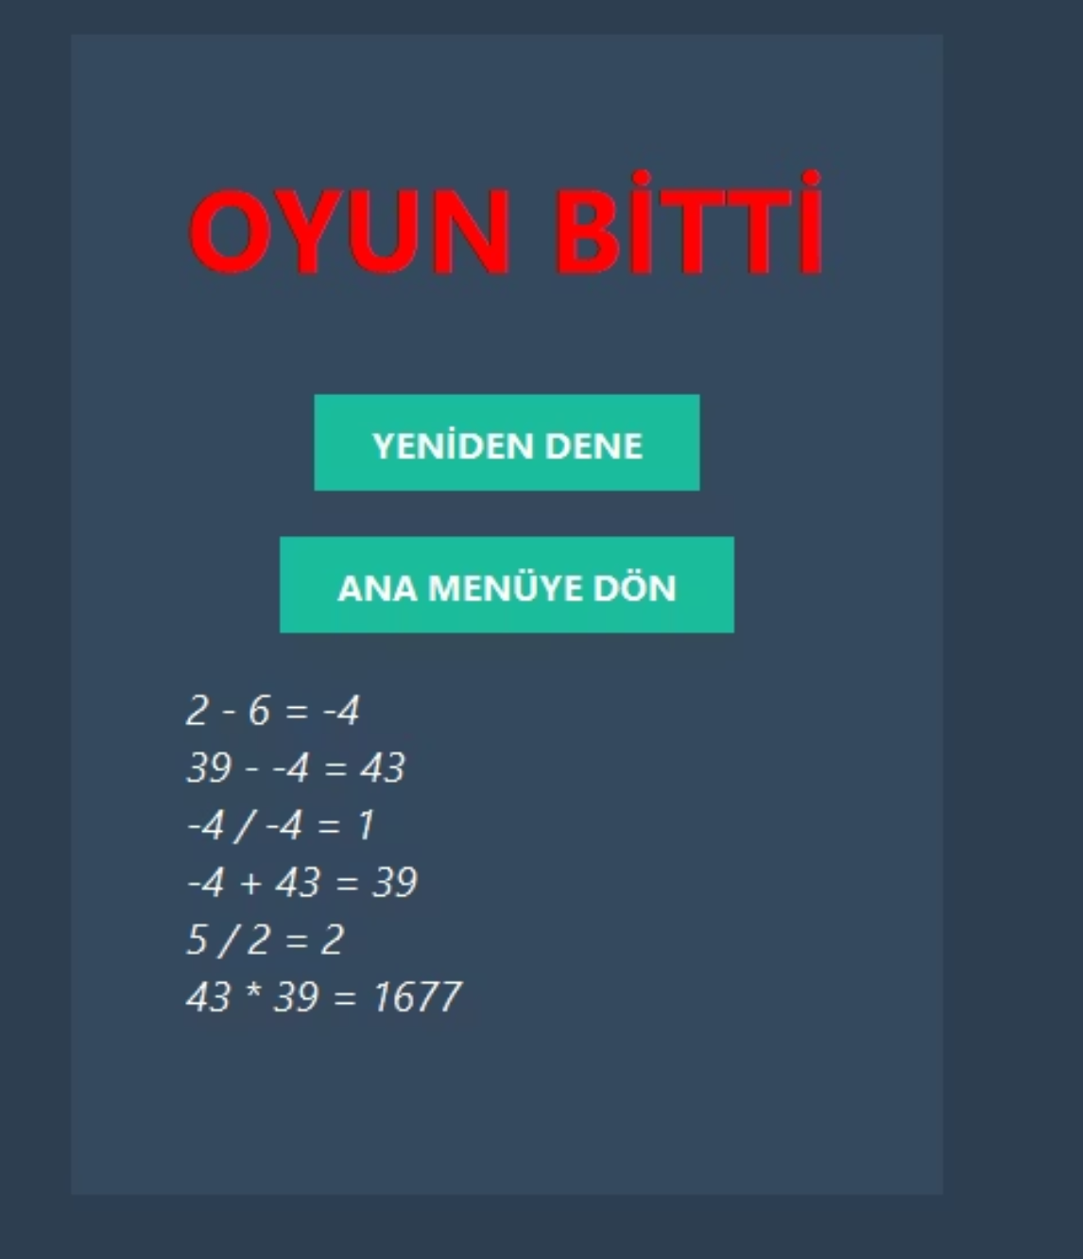
Game Over For Number Game
Time Limit: Game ends when the timer runs out
Solution Review: See the step-by-step operations needed to reach the target number

Slide 15
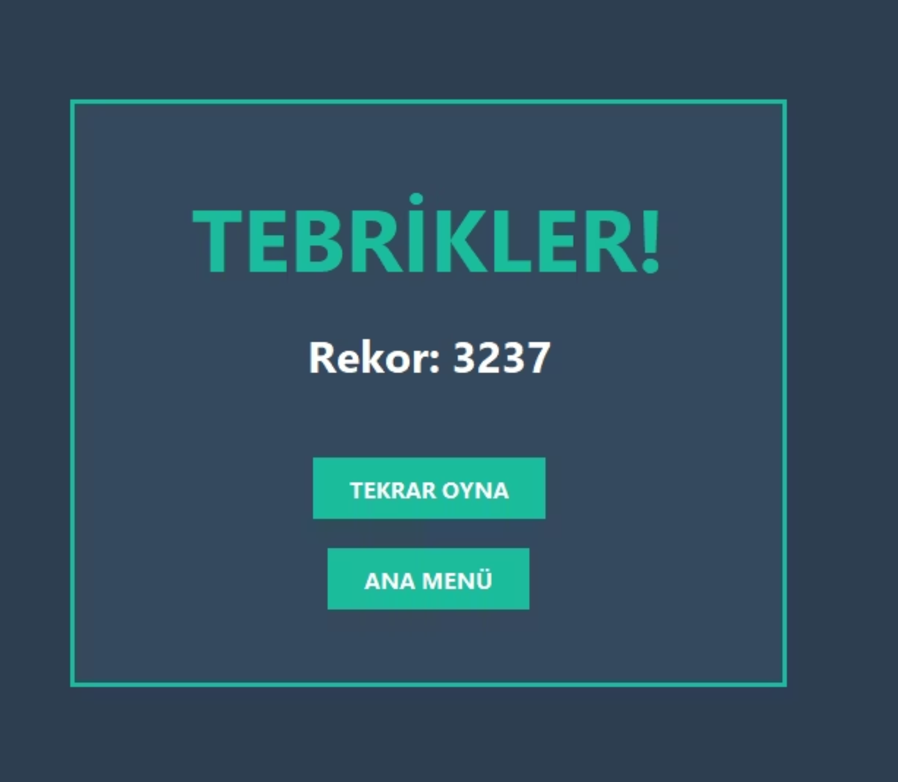
Victory Conditions
Word Game Victory
Construct a valid word and submit it before time expires to claim your win.
Number Game Victory
Reach the exact target number with your calculations to win instantly.

Slide 16










Architecture & Component Flow
Frame
GameManager
GUI & UI layer - Renders all visual components, handles user interactions, and manages event listeners
Main entry point & flow control - Orchestrates game flow and manages state transitions
Logic
Game engine & rules - Validates moves, checks victory/game over conditions, manages timer
Database
Persistence & score storage - Tracks player progress, stores high scores, maintains user achievements
Game Modes
Word and Number classes - Implements game-specific logic, calculates scores, validates words and results

Slide 17
Challenges & Solutions
Challenge
Challenge
Timer threads continue running after game ends or exit, ActionListeners stack on buttons, and old data carries over to new games
Initially all logic was in the Logic class - the class couldn't safely close itself, couldn't manage menu transitions, and code became complex and tangled
Solution
Solution
stopLogic() method halts timers, all ActionListeners are removed from buttons, and number/word lists are reset to ensure a clean start
Created GameManager class as a controller that manages when games start/stop and handles menu transitions using CardLayout, treating Logic as a managed object
Key Learning
Memory management and proper resource cleanup are critical for application stability
Key Learning
Separation of Concerns principle in OOP and the importance of a "Controller" class in system hierarchy

Slide 18
Feature Highlights
Advanced Math Operations
Logic Puzzle Mode
Geometry Game
Trigonometry, logarithms, and advanced functions.
Logic puzzles and deductive reasoning challenges.
Shape calculations, spatial reasoning, and visual problem-solving.
Calculus Challenge (University Level)
High School Math Mode
Rapid-fire derivatives and integrals for university students.
Algebra, geometry, and trigonometry challenges for high school students.

